Slide 1

Search for the Best Stats
Contributors:
Kent Huynh, Zeynep Damarli

Slide 2
Project Scope
NBA Box Score Data 2012 - 2018
3 Machine Learning Models
Random Forest
Logistic Regression
Deep Learning
14.000 NBA games
18 Features Examined of 100+

Slide 3
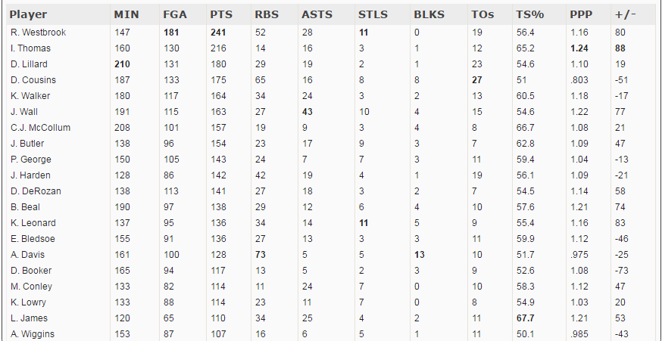
NBA Stats Summary

Slide 4
Assist - a pass that immediately proceeds and sets up a scored basket
Steal- occurs when a defensive player legally causes a turnover by his positive, aggressive action(s).
Rebound- a statistic awarded to a player who retrieves the ball after a missed field goal or free throw.
Block- a block or blocked shot occurs when a defensive player legally deflects a field goal attempt from an offensive player to prevent a score.
eFG% ( Effective field goal percentage) -a statistic used in basketball to take into consideration the additional difficulty of three-point shots and the extra points awarded for making a three-pointer.
(2pt FGM + 1.5 * 3pt FGM) / FGA)
TS% (True shooting percentage)- a statistic that measures a player's efficiency at shooting the ball. (PTS/2(FGA+0.44*FTA)*100
PPP-Points per possession

Slide 5
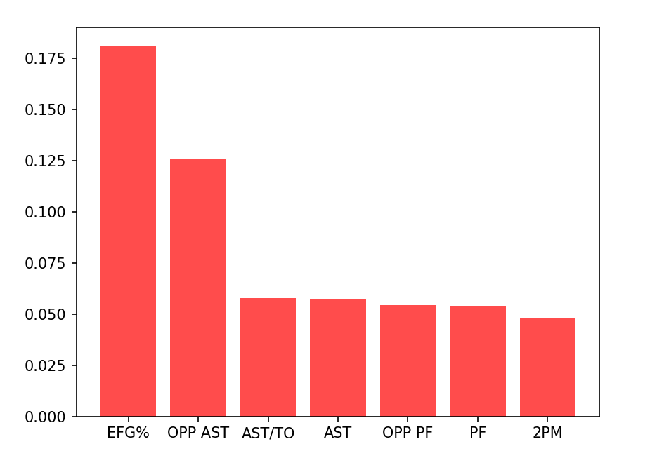
Random Forest - Assists and Shot Effectiveness!
Team Effective Field Goal (EFG)
Assist Stats
Personal Fouls
70% Accuracy - Decision Tree
79% Accuracy - Random Forest

Slide 6

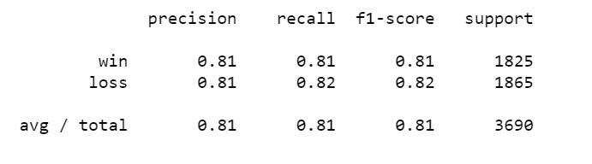
Logistic Regression - Fast and Accurate!
Accuracy Score - 81%

Slide 7
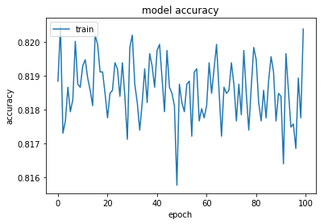
Deep Learning - Additional Epochs Didn’t Result in Incrreased Accuracy
Accuracy did not improve with epochs
Accuracy fell between 79% - 83%
100 Epochs

Slide 8
Tableau Story Time

Slide 9
Project Limitations
The game is dynamic!
NBA strategy changes over time which impacts the data pool
There are many variables that interplay - Focusing on just assists does not guarantee a win
We didn’t cover advance metrics

Slide 10
Conclusion
Effective Field Goal % (eFG%), Personal Fouls, and Assists were the most significant stats
Poorly performing teams might want to focus on improving ball movement - good passes, limiting turnovers
3 Pointers were not as significant as we thought they would be

